Slide 1
Container & Docker

Slide 2
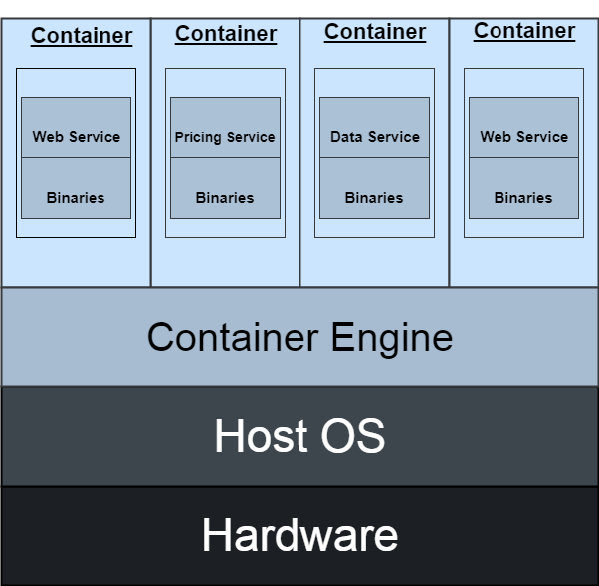
Container - diagram

Slide 3
Defining containers
Containers are lightweight packages of your application code together with dependencies such as specific versions of programming language runtimes and libraries required to run your software services.

Slide 4
Containers- benefits
Like virtual machines, containers allow you to package your application together with libraries and other dependencies, providing isolated environments for running your software services. As you’ll see below, however, the similarities end here as containers offer a far more lightweight unit for developers and IT Ops teams to work with, carrying a myriad of benefits.
Containers are much more lightweight than VMs
Containers virtualize at the OS level while VMs virtualize at the hardware level
Containers share the OS kernel and use a fraction of the memory VMs require

Slide 5
Benefits –continued
Less overhead Containers require less system resources than traditional or hardware virtual machine environments because they don’t include operating system images.
Increased portability Applications running in containers can be deployed easily to multiple different operating systems and hardware platforms.
More consistent operation DevOps teams know applications in containers will run the same, regardless of where they are deployed.
Greater efficiency Containers allow applications to be more rapidly deployed, patched, or scaled.
Better application development Containers support agile and DevOps efforts to accelerate development, test, and production cycles.

Slide 6
Use of containers
1--Agile development
Containers allow your developers to move much more quickly by avoiding concerns about dependencies and environments.
2--Efficient operations
Containers are lightweight and allow you to use just the computing resources you need. This lets you run your applications efficiently.
Run anywhere
Containers are able to run virtually anywhere. Wherever you want to run your software, you can use containers.

Slide 7
Disadvantages of containers
1. Security: Containers share the same host kernel, which can pose a security risk. If a container is compromised, it can potentially affect other containers on the same host.
2. Complexity: Containers can be complex to set up and manage, especially in large-scale environments. Container orchestration tools, such as Kubernetes, can help to simplify the process, but they can also add complexity.
3. Storage: Containers are designed to be stateless, meaning they don’t store data or state. This can make managing persistent data, such as databases, a complex within a container environment.
4. Networking: Containers can be challenging to network, especially across multiple hosts or environments. Container networking can be complex, and it requires careful planning and management to ensure that containers can communicate with each other and with external services.

Slide 8
What is a dockerfile?
Docker builds images automatically by reading the instructions from a Dockerfile which is a text file that contains all commands, in order, needed to build a given image. A Dockerfile adheres to a specific format and set of instructions which you can find at Dockerfile reference.
A Docker image consists of read-only layers each of which represents a Dockerfile instruction. The layers are stacked and each one is a delta of the changes from the previous laye

Slide 9
Contents of file
In the example above, each instruction creates one layer:
FROM creates a layer from the ubuntu:22.04 Docker image.
COPY adds files from your Docker client's current directory.
RUN builds your application with make.
CMD specifies what command to run within the container.

Slide 10
What is a docker ?
Docker works by providing a standard way to run your code. Docker is an operating system for containers. Similar to how a virtual machine virtualizes (removes the need to directly manage) server hardware, containers virtualize the operating system of a server. Docker is installed on each server and provides simple commands you can use to build, start, or stop containers.

Slide 11
Components of Docker Software
Software
Objects
Registry

Slide 12
Benefits of docker
Tailor-made: Most industries want to use a purpose-built. The Docker in cloud computing enables its clients to make use of Docker to organize their software infrastructure.
Accessibility: As the docker is a cloud framework, it is accessible from anywhere, anytime. Has high efficiency.
Operating System Support: It takes less space. They are lightweight and can operate several containers simultaneously.
Performance: Containers have better performance as they are hosted in a single docker engine.
Speed: No requirement for OS to boot. Applications are made online in seconds. As the business environment is constantly changing, technological up-gradation needs to keep pace for smoother workplace transitions. Docker helps organizations with the speedy delivery of service.
Flexibility: They are a very agile container platform. It is deployed easily across clouds, providing users with an integrated view of all their applications across different environments. Easily portable across different platforms.

Slide 13
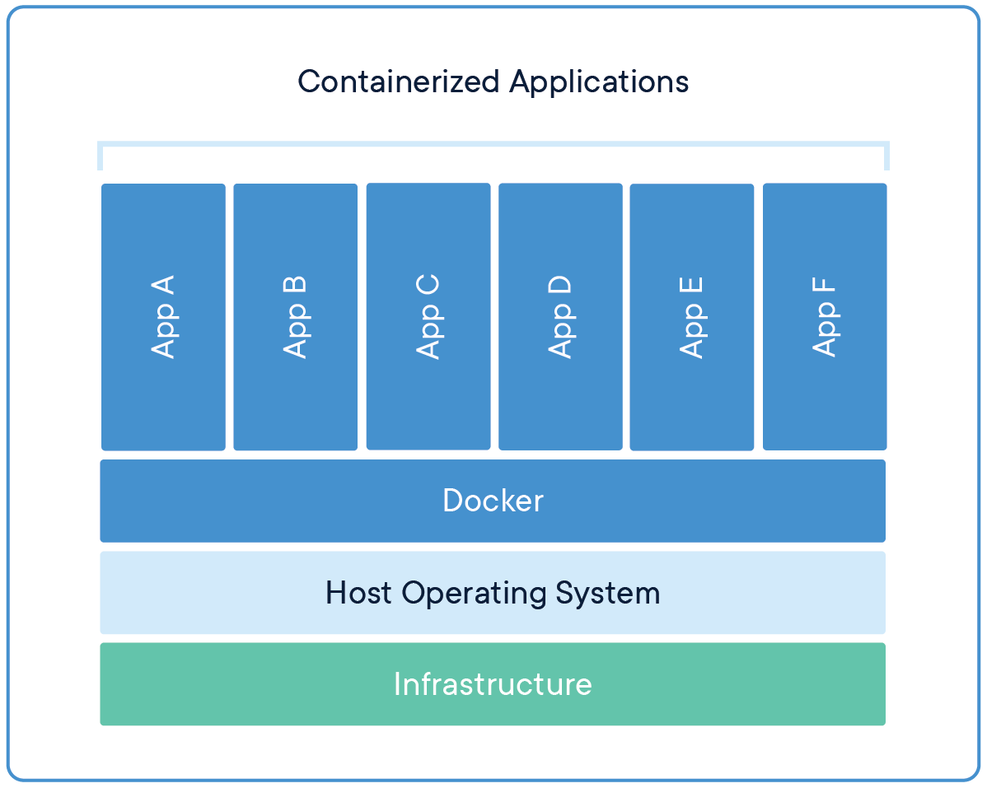
Docker--diagram

Slide 14
More on docker
Docker provides tooling and a platform to manage the lifecycle of your containers:
Develop your application and its supporting components using containers.
The container becomes the unit for distributing and testing your application.
When you're ready, deploy your application into your production environment, as a container or an orchestrated service. This works the same whether your production environment is a local data center, a cloud provider, or a hybrid of the two.
What can I use Docker for?

Slide 15
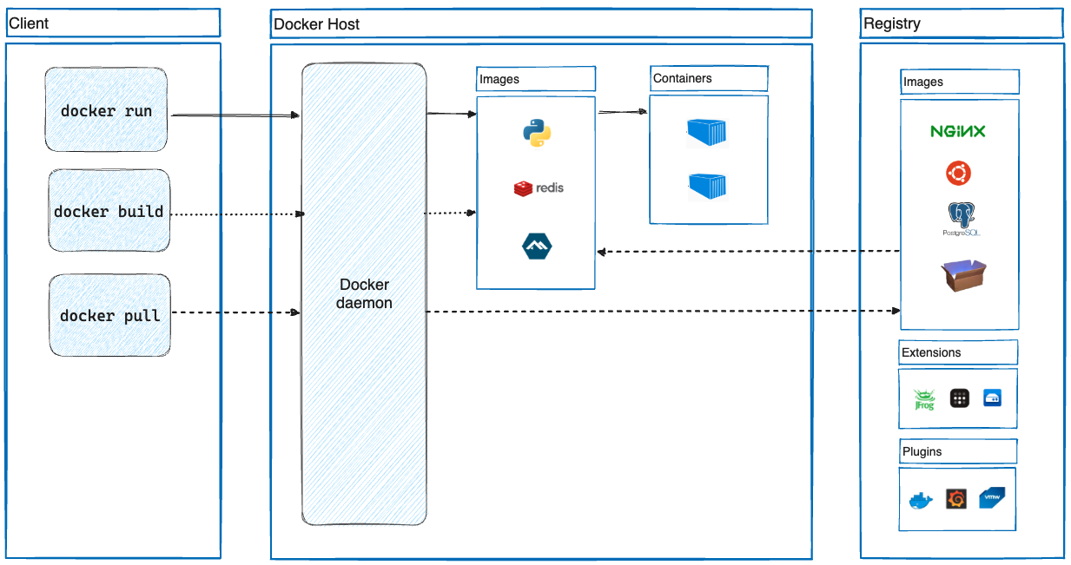
Docker architecture

Slide 16
More on docker
Docker uses a client-server architecture. The Docker client talks to the Docker daemon, which does the heavy lifting of building, running, and distributing your Docker containers. The Docker client and daemon can run on the same system, or you can connect a Docker client to a remote Docker daemon.
The Docker client and daemon communicate using a REST API, over UNIX sockets or a network interface. Another Docker client is Docker Compose, that lets you work with applications consisting of a set of containers.

Slide 17
Terminology in docker
1. Docker Image
It is a file, comprised of multiple layers, used to execute code in a Docker container.
They are a set of instructions used to create docker containers.
2. Docker Container
It is a runtime instance of an image.
Allows developers to package applications with all parts needed such as libraries and other dependencies.
3. Docker file
It is a text document that contains necessary commands which on execution helps assemble a Docker Image.
Docker image is created using a Docker file.
4. Docker Engine
The software that hosts the containers is named Docker Engine.
Docker Engine is a client-server based application
The docker engine has 3 main components:
Server: It is responsible for creating and managing Docker images, containers, networks, and volumes on the Docker. It is referred to as a daemon process.
REST API: It specifies how the applications can interact with the Server and instructs it what to do.
Client: The Client is a docker command-line interface (CLI), that allows us to interact with Docker using the docker commands

Slide 18
Difference between Docker Containers and Virtual Machines
1. Docker Containers
Docker Containers contain binaries, libraries, and configuration files along with the application itself.
They don’t contain a guest OS for each container and rely on the underlying OS kernel, which makes the containers lightweight.
Containers share resources with other containers in the same host OS and provide OS-level process isolation.
2. Virtual Machines
Virtual Machines (VMs) run on Hypervisors, which allow multiple Virtual Machines to run on a single machine along with its own operating system.
Each VM has its own copy of an operating system along with the application and necessary binaries, which makes it significantly larger and it requires more resources.
They provide Hardware-level process isolation and are slow to boot.

Slide 19
Docker file
A Dockerfile is a text document that contains commands that are used to assemble an image. We can use any command that call on the command line. Docker builds images automatically by reading the instructions from the Dockerfile.
The docker build command is used to build an image from the Dockerfile. You can use the -f flag with docker build to point to a Dockerfile anywhere in your file system.
$ docker build -f /path/to/a/Dockerfile .
Dockerfile Instructions
The instructions are not case-sensitive but you must follow conventions which recommend to use uppercase.
Docker runs instructions of Dockerfile in top to bottom order. The first instruction must be FROM in order to specify the Base Image.

Slide 20
What is a kubernetes
Kubernetes is a portable, extensible, open source platform for managing containerized workloads and services, that facilitates both declarative configuration and automation. It has a large, rapidly growing ecosystem. Kubernetes services, support, and tools are widely available.
The name Kubernetes originates from Greek, meaning helmsman or pilot. K8s as an abbreviation results from counting the eight letters between the "K" and the "s".

Slide 21
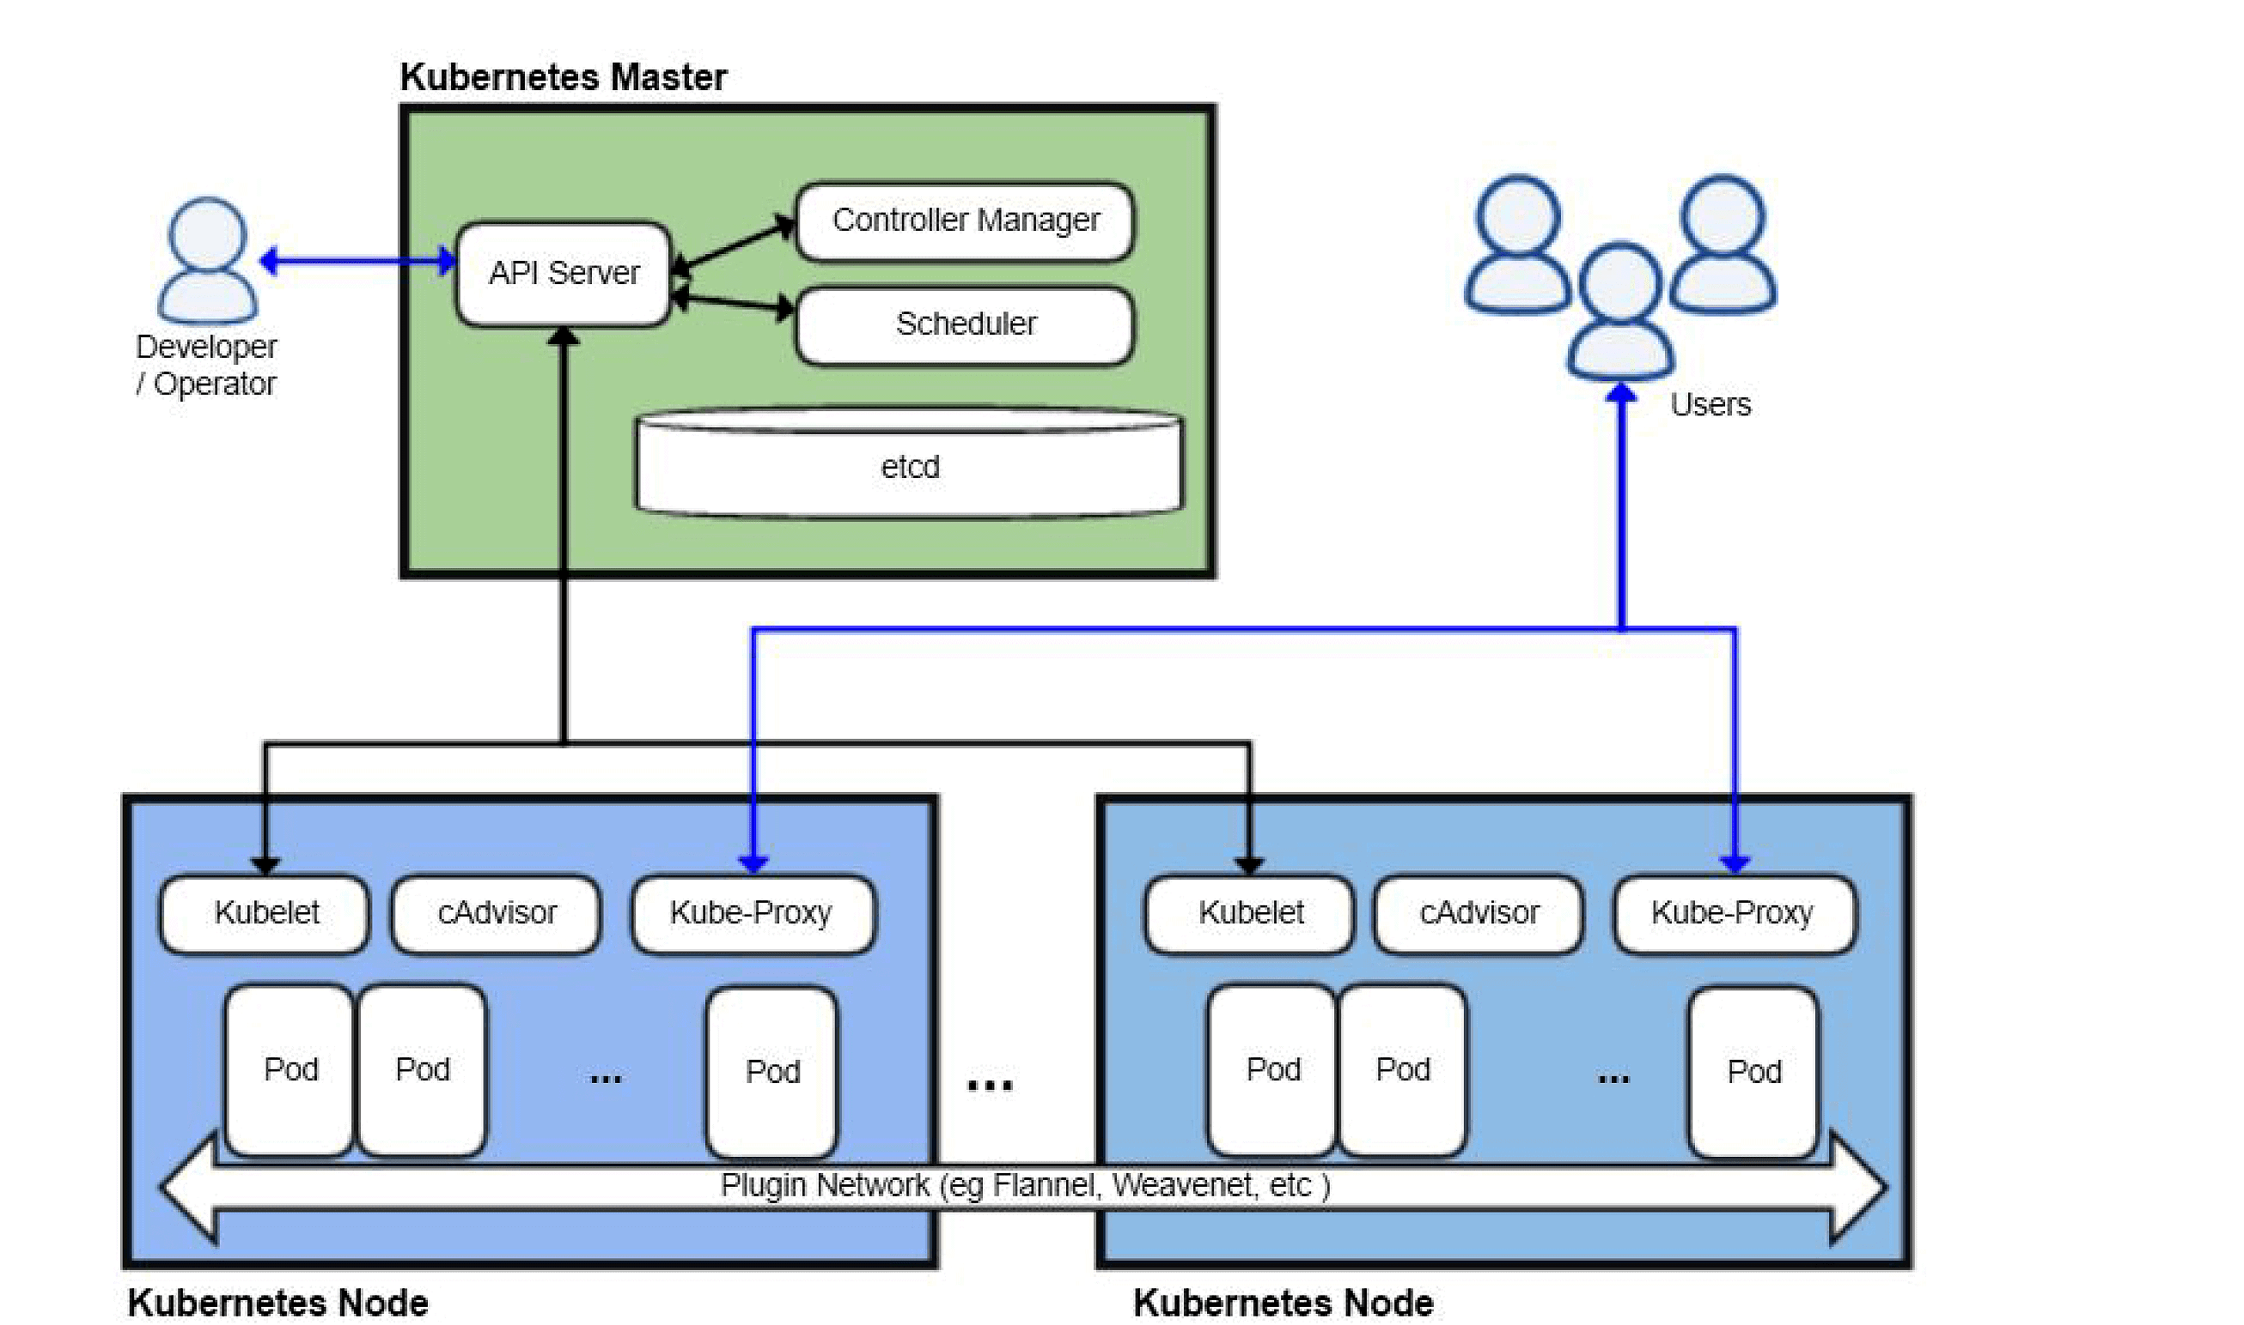
Kubernetes architecture

Slide 22
Describing kubernetes
Kubernetes provides a flexible architecture for discovering services within a cluster while maintaining loose connections. A Kubernetes cluster comprises a set of control planes and compute nodes. The primary role of the control plane is to oversee the entire cluster, expose the API, and manage the scheduling of compute nodes according to the desired settings. The compute nodes run container runtimes such as Docker, alongside a communication agent called kubelet, which interacts with the control plane. These nodes can consist of physical servers, virtual machines (VMs) in on-premises or cloud environments.

Slide 23
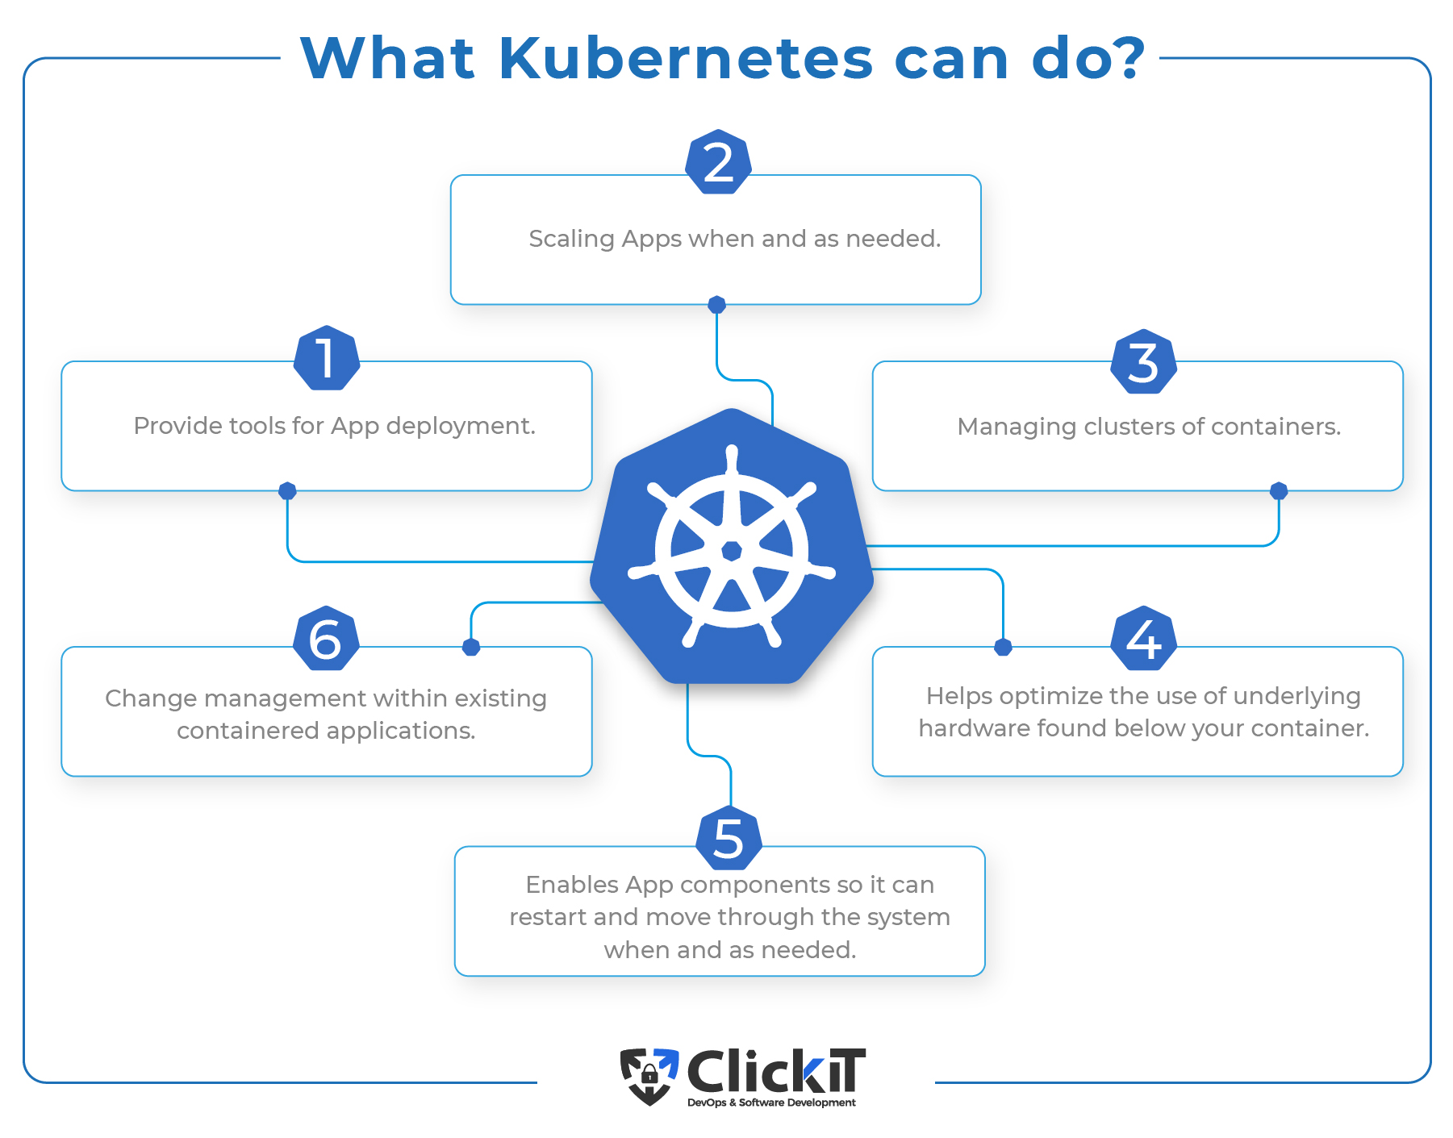
What kuberenetes can do?

Slide 24
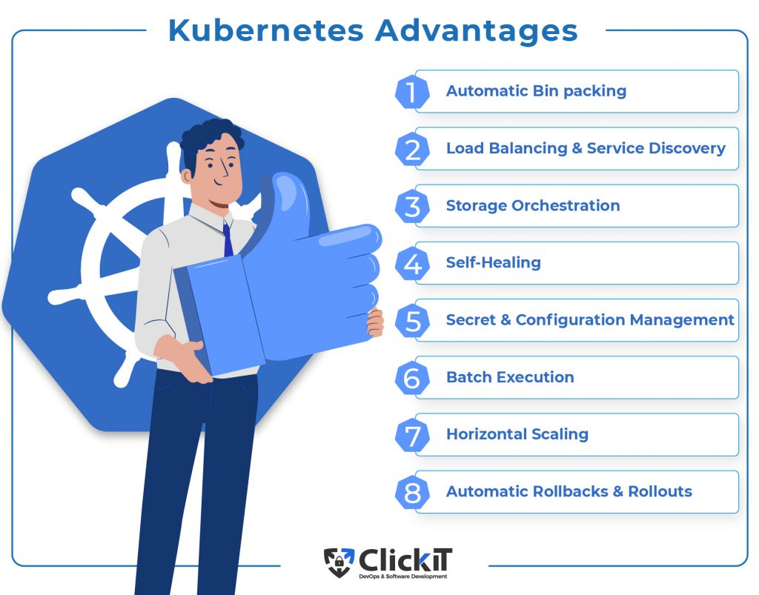
Advantages

Slide 25
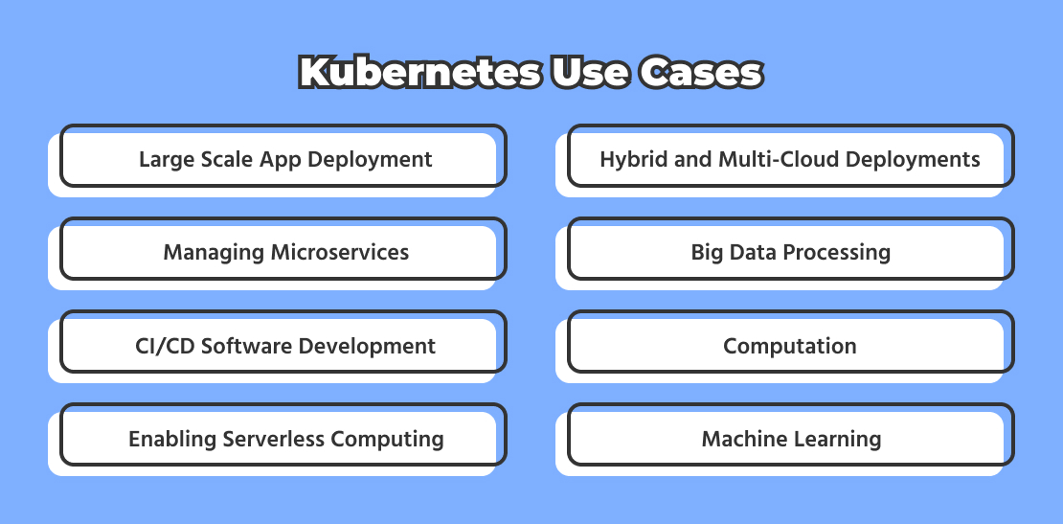
Use cases

Slide 26
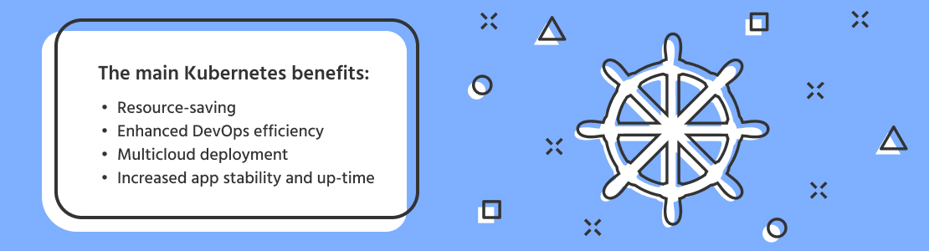
Benefits of kubernetes

Slide 27


